Slide 1
Groups
Lecture 14
Discrete Mathematical Structures

Slide 2
At the Last Class …
Part I: Semigroup and Monoid
  Binary operations and their properties
  Semigroup and monoid
  Isomorphism and homomorphism
Part II: Fundamental Homomorphism Theorem
  Congruence relation
  Quotient semigroup
  Natural homomorphism
  Fundamental homomorphism theorem for semigroup

Slide 3
Groups
Part I: Groups
  Basic properties of groups
  Group of symmetries
  Isomorphism and homomorphism
Part II: Fundamental Homomorphism Theorem
  Quotient group
  Subgroup and cosets
  Fundamental homomorphism theorem for group
  Algebra systems with more than one operation

Slide 4
Group
Group axioms
  Association
  Identity
  Inverse property
Example
  Addition group on integers (Z,+)
  All one-to-one functions on {1,2,3}, plus composition of function: S₃

Slide 5
Inverse
(Inverse can be discussed for those system with identity.)
For a given element x in the system S, if there is some element x’ in the system, satisfying that x’x=1_{S}, then x’ is called a left inverse of x.
Similarly, if there is some x’’ in the system, such that xx”=1_{S}, then x’’ is called a right inverse of x.
For a given element x in the system S, if there is some element x*, satisfying that: xx*=x*x=1_{S}, then x* is called an inverse of x, denotes as x⁻¹.

Slide 6
An Example about Inverse
*
a
b
c
d
Note:
a
a
b
c
d
(1)
b has different left and
b
b
c
d
a
right inverses
c
c
a
c
a
(2)
c
has 2 right inverses, but
d
d
b
c
d
no left inverse
(3) d has left inverse, but no
right inverse

Slide 7
Uniqueness of Inverse
If a system (S,) is associate:
  For a given x, if x has a left inverse, and a right inverse as well, then they must be equal, and it is the unique inverse of x.
    Assuming that the left inverse is x’, and the right inverse is x’’:
    x’=x’  1_{S}=x’ (x  x”)=(x’  x)  x”=1_{S}  x”=x”
  If every element of S has a left inverse, then the left inverse is also its right inverse, and the inverse is unique.
    For any a in S, let b is a left inverse of a, and c is a left inverse of b, then:
    a  b = (1_{S}  a)  b = ((c  b)  a)  b = (c (b  a))  b = (c  1_{S})  b = c  b = 1_{S}

Slide 8
Inverse Property of a System
For any element in a system, there may or may not be its inverse.
However, “for any element x in S, x has its inverse” is a property of the system as a whole.
For a system for which the inverse property holds, each element has its particular inverse.

Slide 9
Semigroup and Group
A group is a semigroup
  Association
A group is a monoid
  Identity
Negative exponential
  Denotation of inverse of element a: a⁻¹
  Expansion of exponential: a^{-k} =(a⁻¹)^{k} (k is positive integer)
Abelian group: commutative group

Slide 10
An Example of Abelian Group
Let G be the set of all nonzero real numbers, let a*b=ab/2, then (G,*) is a Abelian group.
Verifying that all requirements as described as definition are satisfied:
  “*” is a closed binary operation on G.
  Associativity: (a*b)*c=a*(b*c)=(abc)/4
  Identity: a*2=2*a for all a in G
  Inverse: examine the equation a*x=2, it is easy to see that for all a in G, a ^{–1}=4/a
  Commutativity: obviously, a*b=b*a

Slide 11
Product of groups
Given two groups (S, ), (T,*), define operation “⊗” on the Cartesian product S×T as follows:
  <s₁,t₁> ⊗ <s₂,t₂> = <s₁  s₂, t₁*t₂>
(S×T, ⊗) is a group:
  Association: <(r₁  s₁)  t₁, (r₂*s₂)*t₂>
  = <r₁ (s₁  t₁), r₂*(s₂*t₂)>
  Identity: <1_{S}, 1_{T}>
  Inverse property: the inverse of <s, t> is <s⁻¹, t⁻¹>
    (where s, s⁻¹∈S, t, t⁻¹∈T)

Slide 12
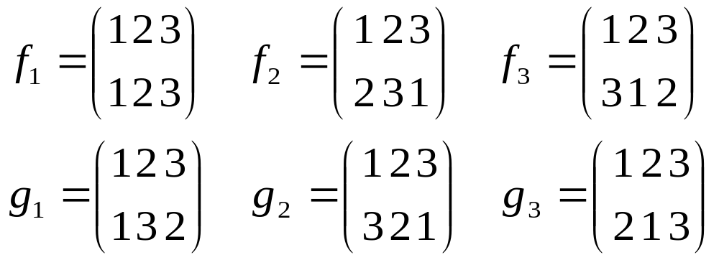
An Example of non-Abelian Group
Six one-to-one functions can be defined on the set {1,2,3} altogether:
({e,α,β,γ,δ,ε}, ) is a group, here, “” is composition of function. One-to-one function on finite set is called a permutation, so, this is a permutation group, denoted as S₃.

Slide 13

Geometric Interpretation of S₃
Each one-to-one correspondence on the set of points is a symmetry of the triangle.
3
Note: f₂*g₂=g₁
l₂
l₁
2
2
l₁
l₃
l₃
l₁
1
l₃
2
3
l₂
1
1
l₂
3
3 rotations: f₁-0°, f₂-120°, f₃=240°
3 reflectings: g₁-by l₁, g₂-by l₂, g₃-by l₃

Slide 14
Cancellation Properties
Cancellation property holds for group:
  Let (G, ) be a group, for any a,b,c∈G
  If a  b=a  c, then b=c
  If b  a=c  a, then b=c
The algebraic system (Z⁺, ·), where Z⁺ is the set of positive integers, and “·” is arithmatic multiplication, satisfies association and cancellation, but it is not a group.

Slide 15
Group Equation and Its Solution
Group equations:
  a  x=b and y  a=b, where a, b are constants
Solutions of the group equations:
  a  x=b → a (a⁻¹  b)=b
  y  a=b → (b  a⁻¹)  a=b
The group equation has unique solution:
  Assuming that a  x₁=b= a  x₂, multiply the two sides of the equation from the left with a⁻¹, x₁= a⁻¹  b=x₂,

Slide 16
Second Definition of Group
(G, ) is an algebraic system, if association holds for it, and the two group equation a  x=b and y  a=b have unique solutions each, then (G, ) is a group.
  Sketch of proof:
  Let b is any element in G, y  b=b has a unique solution e, then it is easy to prove that e is a left identity in (G, ).
    For any a∈G，b  x=a has a unique solution c, then e  a=e  b c= b  c=a
  For any a∈G，ya=e has a unique solution a’ (“left inverse candidate”), then a’ is also “right inverse candidate” of a:
    y⃘a’=e has a unique solution a”, then a  a’= e ( a  a’)= (a”  a’) (a  a’)=e
  e is also right identity: for any a∈G, a  e= a (a’  a)=a
Combining (1)-(4), e is the identity of (G,), and for any element a, a has a’ as its inverse.

Slide 17
Finite Group and Cancellation
Let G be a finite set, if the algebraic system (G, ) satisfies association and cancellation properties, then (G, ) is a group.
  Sketch of proof:
  Assuming that G={a₁,a₂,a₃,…,a_{n}}，for any given a_{i} in G, considering the set a_{i}G={a_{i}  a₁, a_{i}  a₂, a_{i}  a₃, …, a_{i}  a_{n}}. Note that a_{i}G is a subset of G (closeness of G), but it must has the same number of element with G (cancellation), so, a_{i}G=G, which means that the equation a  x=b has a unique solution. (Why?)
  Similarly, the equation y  a=b has also a unique solution.
  So, (G, ) is a group.

Slide 18

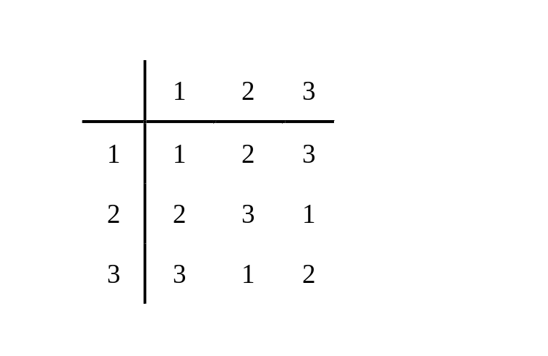
Operation Table of Group
There is no identical elements in any row or any column.
  Let G={a₁,a₂,…,a_{n}}
  If there are two identical elements in ith row, at locations k, l, then the equation a_{i}*x=a_{j} has two different solution, contradiction.
  Same for column.
  For a group with 3 elements

Slide 19
Isomorphism
Group (G₁, ) and (G₂,*) are isomorphic (G₁≅G₂) if and only if:
  There exist a one-to-one correspondence f: G₁→G₂, such that: (f is called an isomorphism)
  For any x,y∈G₁, f (x  y) = f (x) * f (y)
Isomorphism is an equivalence relation.
  Reflexibility: the identity function is a one-to-one correspondence.
  Symmetry: inverse of a one-to-one correspondence is also a one-to-one correspondence.
  Transitivity: the composition of two one-to-one correspondence is also a one-to-one correspondence.

Slide 20
Homomorphism
Group (G₁, ) and (G₂,*) are homomorphic, denoted as (G₁~ G₂) is and only if:
There exists a function f: G₁→G₂ such that:
  for any x,y∈G₁, f (x  y) = f (x) * f (y)
If f is also onto, then G₂ is a homomorphic image of G₁.
Note: isomorphism is a special case of homomorphism
Example: integer addition group (Z,+) and mod-3 addition group (Z₃,+₃)
  homomorphism: f : Z→Z₃, f(3k+r)=r
f

Slide 21
Homomorphic Image and System Properties
Association
  Assuming that f: G₁→G₂ is a homomorphism, and G₂ is a homomorphic image of G₁, then, if G₁ is associative, so is G₂, i.e. for any x,y,z∈G₂,(x  y)  z=x (y  z)
  Proof: for any x’,y’,z’∈G₂, since f is onto, there must be x,y,z∈G₁, such that f(x)=x’, f(y)=y’, f(z)=z’. So, (x’*y’)*z’ = (f(x)* f(y))* f(z) = f(x  y) * f(z) = f((x  y)  z) = f(x (y  z)) = f(x)* (f(y)* f(z)) = x’*(y’*z’)
Same discussion applies for commutation.

Slide 22
Homomorphic Image and System Properties
Identity
  Assuming that f: G₁→G₂ is a homomorphism, and G₂ is a homomorphic image of G₁, then, if G₁ has an identity e, so does G₂, i.e. there exists e’ in G₂, such that for any x∈G₂, (x*e)=(e*x)=x
  Proof: for any x’∈G₂, since f is onto, there must be x∈G₁, such that f(x)=x’. Let f(e)=e’, then, (x’*f(e)) = (f(x)* f(e))= f(x  e) = f(x) = x’. (f(e)*x)=x can be proved similarly.
  Note that f(e) is in G₂, so, it is the identity of G₂.

Slide 23
Subgroup
Let H be a nonempty subset of a group G such that:
  The identity e of G belongs to H
  If a and b belong to H, then ab∈H
  If a∈H, then a⁻¹∈H
Then H is called a subgroup of G.
Note: subgroup is itself a group, and the properties above are not independent
Example: cyclic subgroup: H={a^{i}|i∈Z }, where a is a randomly specified element of G.

Slide 24
Homomorphism and Subsystem
Let f be a homomorphism from a group (S, ) to a group (T,*). If S’ is a subgroup of (S, ), then
f(S’)={t∈T|t=f(s) for some s∈S’}
the image of S’ under f, is a subgroup of (T,*)
Proof
  Closedness of f(S’)
  Associativity hold on f(S’)

Slide 25

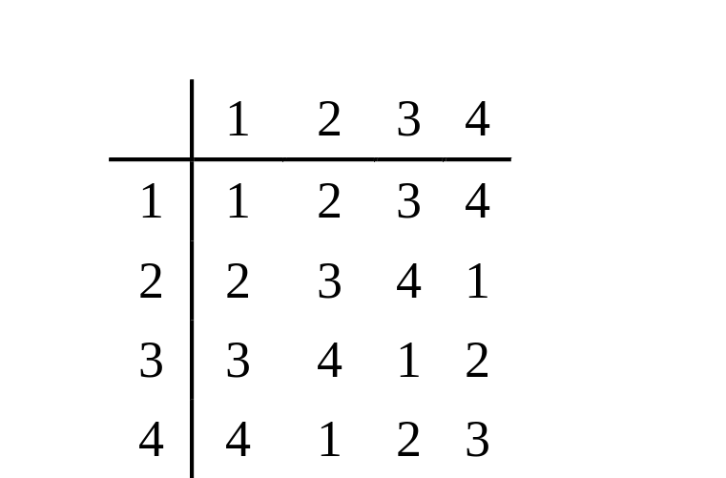
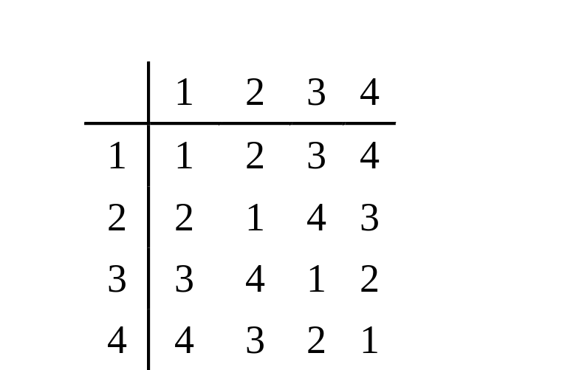
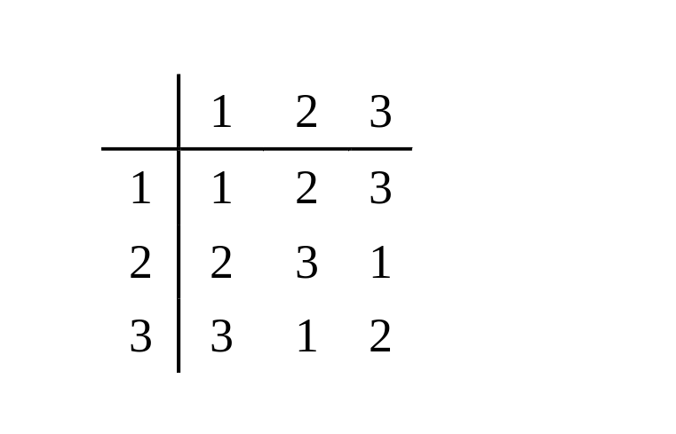
Groups with Three or Four Elements
If isomorphic groups are considered as the same, then:
There is only one group with 3 elements.
There is only two groups with 3 elements.

Slide 26
Product of Cyclic Group
(Z_{n},+_{n}) is a finite cyclic group for each n.
Z₂×Z₂ ≅ Z₄
Z_{m}×Z_{n}≅Z_{mn} if and only if m,n are relatively prime
If GCD(m,n)=1, we need only to prove that Z_{m}×Z_{n}is cyclic. In turn, it can be achieved by proving there is an element of x of order mn in Z_{m}×Z_{n}.
    (1,1)^{mn} = (1,1)
    If (1,1)^{k} = (1,1), then k must be one of the common multiplier of m,n. If k<mn, then GCD(m,n)>1, but m,n are relatively prime.
    So, |(1,1)| = mn。
  If C_{m}×C_{n}≅C_{mn} C_{m}×C_{n} is cyclic，the generator is unique, that is (1,1).

Slide 27
Quotient Group
Let R is a congruence relation on the group (S,*). S/R is the quotient set, i.e. the set of all equivalence classed.
Define an operation ⊗ from S/R×S/R to S/R as [a]⊗[b]=[a*b]. Note the operation is well-defined because R is a congruence relation.
  Suppose ([a],[b])=([a’],[b’]), then aRa’, bRb’, by the definition of congruence relation, a*b=a’*b’, so ⊗ is a well-defined function from S/R×S/R to S/R
(S/R,⊗) is a group, called quotient group, for any [a], the corresponding inverse is [a⁻¹]

Slide 28
Coset – Left or Right
H is a subgroup of group G, for any a in G, we can define a set ,aH, of G as following:
aH={a⃘h|h∈H}
aH is called a left coset of H.
  Closeness of G implies that aH is a subset of G.
  ∀h∈H, ah∈H if and only if a∈H, (Why?)
Similarly, we can define right coset of H.

Slide 29
Normal Subgroup
Definition: a subgroup H of G is normal means that, for any a∈G, Ha=aH。(H⊴G)
Ha=aH if and only if For any h_{i}∈H, a∈G，there must be some h_{j}∈H，such that h_{i}a=ah_{j}。
  (Not that for any h_{i}∈H, a∈G, h_{i}a=ah_{i}。)
Let N is a subgroup of G, N is normal if and only if : for any g∈G, n∈N, gng⁻¹∈N。
  ⇒ for any g∈G, n∈N, there is a n₁∈N, such that gn= n₁g, so, gng⁻¹ = n₁∈N ；
  ⇐ prove that gN ⊆ Ng : for any gn∈gN , we know that gng⁻¹∈N ，let gng⁻¹= n₁，then gn= n₁g∈Ng；Similarly for Ng⊆ gN。

Slide 30
Right Coset Relation
H is a subgroup of a group G. Define a relation R on G as following:
  for any a,b∈G, aRb iff. ab⁻¹∈H
  In fact, aRb means that a,b belong to the same right coset.
    aRb⇒ab⁻¹∈H ⇒ ab⁻¹=h_{i}, h_{i}∈H ⇒ a∈Hb
  The relation is an equivalence.

Slide 31
Congruence Relation
A familiar example:
  a≡b (mod 3) iff. |a-b|/3 is an integer
    Equivalence classes: π₁={…-3,0,3,6,9,…}
    π₂={…-2,1,4,7,10,…}
    π₃={…-1,2,5,8,11,…}
Characteristics of the operation on classes:
  aRb, cRd ⇒ ac R bd
Congruence relation in general

Slide 32
Coset Relation about Normal Subgroup
If N is a normal subgroup of a group G, then:
If ap⁻¹∈N, bq⁻¹∈N, then (ab)(pq)⁻¹∈N
  Let ap⁻¹=n₁, bq⁻¹=n₂ (n₁,n₂∈N)
  then (ab)(pq)⁻¹ = abq⁻¹p⁻¹ = an₂p⁻¹
  Notice that N is normal, so, an₂=n₃a (n₃∈N)
  So, (ab)(pq)⁻¹ = n₃ap⁻¹ =n₃n₁∈N

Slide 33
Operation on Coset
Given a normal subgroup of a group G,
Define an operation on right coset of H as following:
  Ha*Hb = H(ab) , ab is the operation of G.
* is a well-defined operation: the result of the operation “*” doesn’t depend on the selection of the representative element.
  It is guaranteed by normal subgroup.

Slide 34
Quotient Group
If N is a normal subgroup of a group G, then (G/N, *) is also a group.
  Closedness;
  Associativity;
  Identity: N itself;
  Inverse: the inverse of Na is Na⁻¹
(G/N, *) is called a quotient group of G.

Slide 35
Homomorphism Kernel
G₁, G₂ are groups, f: G₁→G₂ is a homomorphism, define a set ker f = {x|x∈G₁,f(x)=e₂}, where e₂ is the identity of G₂, ker f is called the homomorphism kernel.
Identity of G₂
ker f
G₁
Homomorphism f
G₂

Slide 36
Kernel is a normal subgroup
ker f is a normal subgroup of G₁
  Nonemptiness: the identity of G₁belongs to ker f ;
  Subgroup: for any a,b∈ ker f , we have f(a)=f(b)=e₂; So, f(a⃘b⁻¹) = f(a)*[f(b)]⁻¹= e₂
  Normal: for any a∈ ker f ,x∈G₁, we have f(a)=e₂; so, f(x⃘a⃘x⁻¹) = f(x)* f(a)*[f(x)]⁻¹ =e₂

Slide 37
Natural Homomorphism
Any group G is onto homomorphic to its quotient G, called “Natural homomorphism”
  Define g:G→G/N, for any a∈G, g(a)=Na. Obviously, g is onto function.
  G is a homomorphism
    For any a,b∈G: g(a⃘b)=N(a⃘b) =Na*Nb= g(a)*g(b)
  ker g is N:
    Nis the identity of the quotient group.g(x)=N ⇔ x∈N

Slide 38
A Congruence Relation Determined by a Homomorphism
Two groups
R defined on G
a₁
f(a)=f(a₁)
a
It is easy to prove that R is an equivalence.
R is a congruence relation:
f(ab) = f(a)*f(b)
f(a₁b₁) = f(a₁)*f(b₁)
However: f(a)*f(b) = f(a₁)*f(b₁)
Which means:
f(ab) = f(a₁b₁)
That is: (ab)R(a₁*b₁)
b₁
f(b)=f(b₁)
b
f
(G’,*)
(G,)
f is a homomorphism

Slide 39

Fundamental Homomorphism Theorem
Define g: S/R→G’ as following:
g([a])=f(a) for any [a]∈S/G’
1. g is a function: that is for any other
element a’ in [a], g[a’]=f[a]
2. g is one-to-one: all element a having the same value of f(a) are in one equivalence class.
3. g is onto: for any b∈T, there is some a∈S, such that f(a)=b, then g[a]=b.
4. g is an isomorphism:
g([a]⊗[b])=g([ab])=f(ab)=f(a)*f(b) =g([a])*g([b])
Homomorphism
f
(G,)
(G’,*)
f_{G’}
?
Natural
homomorphism
G
/
G’
Quotient
group

Slide 40
Home Assignments
To be checked
  pp.357: 6, 12, 18, 19, 21, 24, 26, 28-39
  pp.362: 1, 6, 12-13, 22, 26-37
Self tests

